Slide 1

Heart Disease Diagnostic Analysis
Presented By
MANTHAN SHARMA

Slide 2

Problem Statement
Extract, Transform and Load data from the heart disease diagnostic database. You can perform EDA through python. The database extracts various information such as Heart disease rates, Heart disease by gender, by age.
Make the necessary dashboard with the best you can extract from the data. Use various visualization and features and make the best dashboard. Find key metrics and factors and show the meaningful relationships between attributes.

Slide 3

Heart Disease Diagnostic Analysis Dashboard

Slide 4
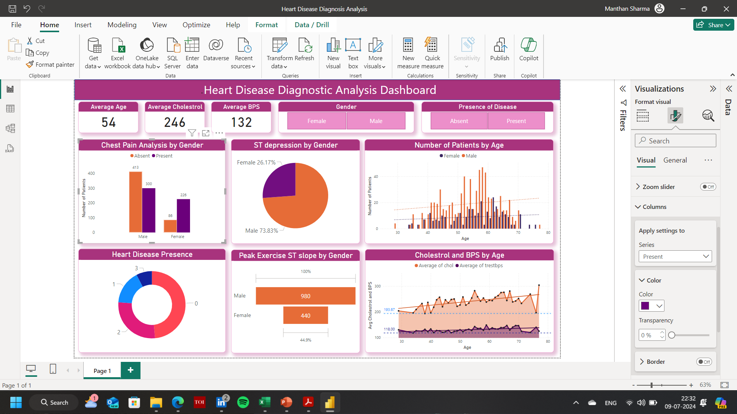

Slide 5

Total target patients consists of 713 Male patients and 312 female patients.
The highest number of Male patients (47 patients) are of 58 years of age. On the other hand, 24 female heart patients (highest number acc. to age) are 62 years old.
Discrepancy in number of Male and Female heart patients was analysed to be the most at the age of 59, when the Male patients were 40 higher than their peers.

Slide 6
The Chest Pain was a symptom in the 526 of the total(1025) target patients.
59.71% of the chest pain was diagnosed in the Male patients.
The most diversion in the chest pain analysis was seen to be in the female patients, which was 140 (presence) higher than the absence of the symptom.

Slide 7
In the analysis it was clear that 810 of the male patients accounted for the total ST depression.
In the contrary, only 288 of the female patients were confirmed to have an ST depression in their ECGs.

Slide 8
The highest Average cholesterol level was obtained for a 77 year old patient, and the lowest was of the 38 year old patient.
Across all the patients, the average cholesterol ranged from 193.67 to 304.00.
The average BPS ranged from 118.00 to 148.63.
Average cholesterol and average BPS diverged the most at the age of 77, when average cholesterol was 179 higher than the average BPS.

Slide 9


Summary
From the overall population, Males account for the 73.83% of the total ST depression reading in their ECG, while female accounts for the rest 26.17%.
We can see that a higher number of people are suffering from Typical Angina type of Chest Pain.
59.71% of the chest pain was diagnosed in the Male patients.
The highest number of Male patients (47 patients) are of 58 years of age. On the other hand, 24 female heart patients (highest number acc. to age) are 62 years old.

Slide 10




Thank you
Manthan Sharma
manthans2001@gmail.com

